Slide 1

MedRAX: Medical Reasoning Agent for Chest X-ray
Dominik Garstenauer
Technische Universität München
Munich, 18. Juni 2025
[1] MedRAX: https://arxiv.org/abs/2502.02673

Slide 2
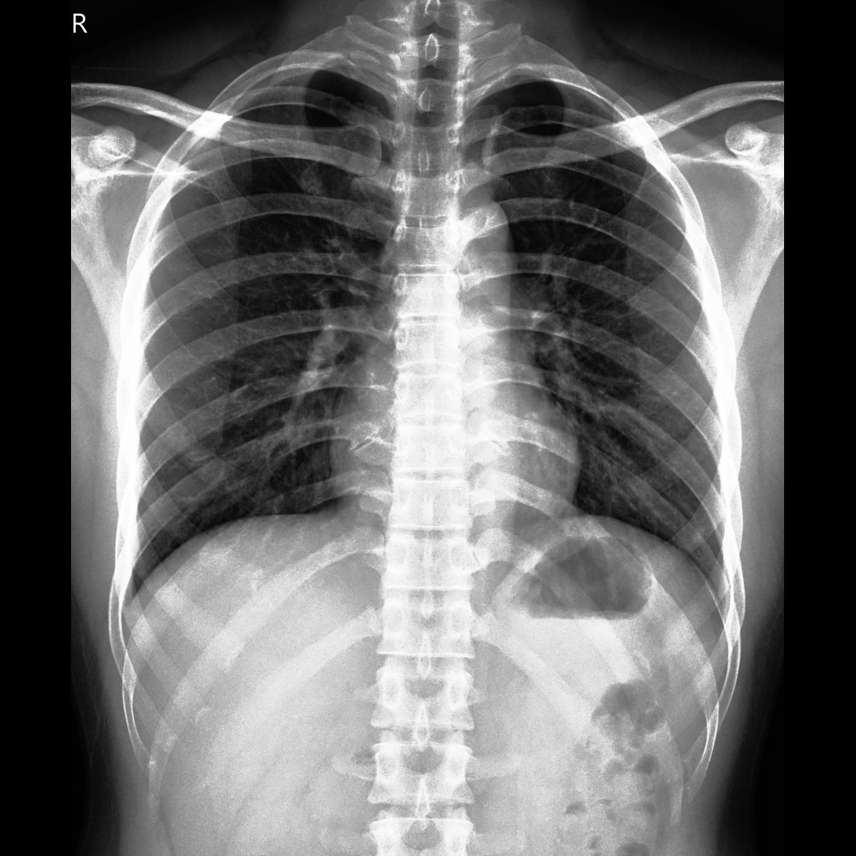
The clinical burden of chest x-rays
Guess – How many chest x-rays are performed anually worldwide?
Hint: it is the largest proportion of diagnostic radiology procedures
A: 4.2 Billion = 4.2 * 10⁹ per year [2]
Huge time burden on radiologists
Notes:
- chest-xrays are used to make critical decisions in disease detection, diagnosis, and monitoring
- Think back to Prof. Dr. Benedikt Wiestler talk.. This number is only increasing: more chest-xrays per patient,
Proportion is 55,1% in America
Regarding classifgication, grounding, segmentation, report generation, etc. ..
So what is the solution: as we all know DL & VLMs ..

Slide 3
The sea of solutions
Task-specific models vs. Foundation Models
Segmentation:
MedSAM, PSPNet, ...
Grounding:
Maira-2, ..
Report Generation:
Chestbiox-gen, ...
Disease Classification:
CheXNet, TorchXRayVision,...
...
GPT-4(V)
Llama
Qwen
LLaVA-Med
CheXagent
...
How to integrate these indivdual tools while leveraging their strengths?
Notes:
Last Week we learned about a vision-language Foundation Model (Qwen 2.5) and another paper called Visual-RFT which proposed a RL technique to fine-tune such models to perform better on specific tasks with only a small amount of labelled data needed.
Each have strengths and weaknesses
specialized knowledge vs fragmentation and clinical adaptation
(reasoning & generalization vs reliability: halluconations & FP & inconsistencies in reasoning )
We need an end to end solution with the relabiltiy (low FP) of the task-specific sols and the general reasoning powers of foundation models
- LMMs experience hallucinations and inconsistencies in reasoning, particularly concerning where medical accuracy is paramount. They struggle with complex multi-step reasoning required for diagnostic tasks, failing to systematically evaluate all relevant anatomical structures or integrate findings across different image region

Slide 4
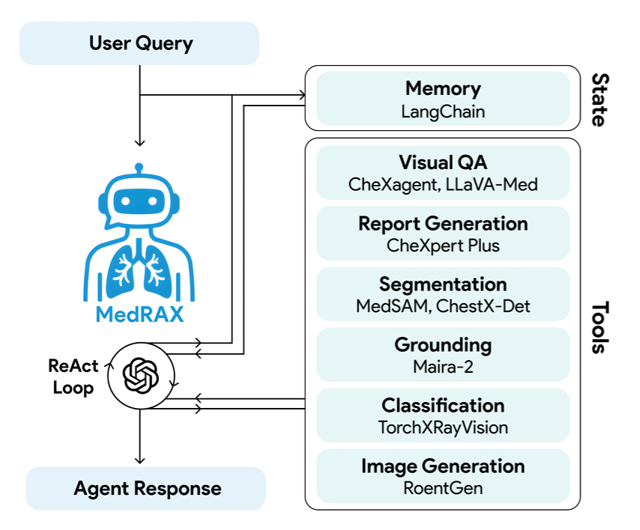
The agentic AI era – MedRAX Overview
+ CXR image(s)
Parallel execution
GPT-4o
Notes:
Fallahpour et al propose MedRax an „agent“: what is an agent? A framwoerk that combines (1) a reasoning engine driven by LLMs, (2) perceptual modules that process multimodal inputs, and (3) action mechanisms that execute API calls, retrieve information, or interact with external tools.

Slide 5
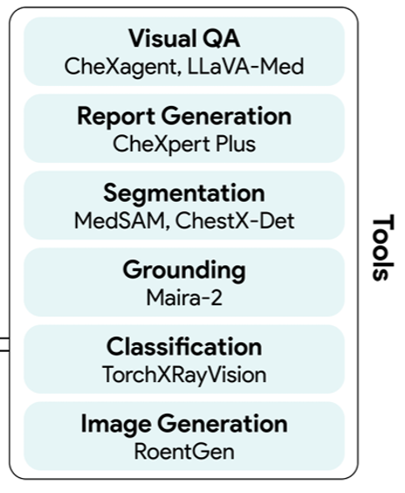
The tools
Notes:
QUICKLY!
VQA: Answering free-form questions about CXR images by combining visual understanding with medical knowledge.
CheXagent, a vision-language foundation model trained on CheXinstruct, with over 8.5M samples across 35 tasks, capable of fine-grained visual reasoning and CXRinterpretation
LLava-Med, a biomedical 7B VLM, trained on 600K biomedical image-caption pairs from PMC-15M and 60K instruction-tuning data

Slide 6
The tools
Notes:
QUICKLY! Report Generation. Writing radiology reports with findings and impressions.
Model: A SwinV2 Transformer with a two-layer BERT decoder trained on 223K expert-annotated reports from CheXpert Plus dataset to generate findings and impressions (

Slide 7
The tools
Notes:
QUICKLY!Segmentation. Partitioning CXR images into semantically meaningful regions by assigning each region to anatomical structures.
-MedSAM, a state-of-the-art biomedical segmentation model trained on 1,570,263 medical image-mask pairs, covering 10 imaging modalities and over 30 cancer types

Slide 8
The tools
Notes:
QUICKLY! Grounding. Localizing specific visual regions in medical images that correspond to given textual descriptions or findings.
Model:
Maira-2, a 7B VLM trained on MIMIC-CXR, PadChest, and USMix datasets, excellent in grounding specific phrases or generating findings of a radiology report with or without grounding (Bannur et al., 2024).

Slide 9
The tools
Notes:
Disease Classification. Detecting and classifying pathologies and abnormalities.
Model: A DenseNet-121 model from the TorchXRayVision library, trained on NIH ChestX-ray, CheXpert, MIMIC-CXR, and PadChest datasets. It can predict 18 pathology classes including Pneumonia, Pneumothorax, Edema, Effusion, and Nodule (Cohen et al., 2022; 2020).

Slide 10
The tools
Notes:
• Chest X-ray Generation. Synthesizing realistic CXR images from text descriptions of anatomical features and pathologies.
Model: RoentGen, a medical vision-language model adapted from Stable Diffusion, trained on the MIMICCXRdataset, generates diverse, high-fidelity chest X-rays given text prompts (Chambon et al., 2022).

Slide 11
The tools
+ Utilities
Notes:
Utilities. Processing DICOM images, generating custom plots, and visualizing figures to user.

Slide 12
The agentic AI era – MedRAX Overview
+ CXR image(s)
Parallel execution
GPT-4o
Notes:
Now lets look at the brain of the agent, the reac tloop- so how are the tools called?
So instead of having to implement a fixed flow of information for each use case: e.g. Tool1 , then tool5, then tool3, .. Then output, we leverage LLMs great reasoning capabilities to do that for us dynamically for us!

Slide 13
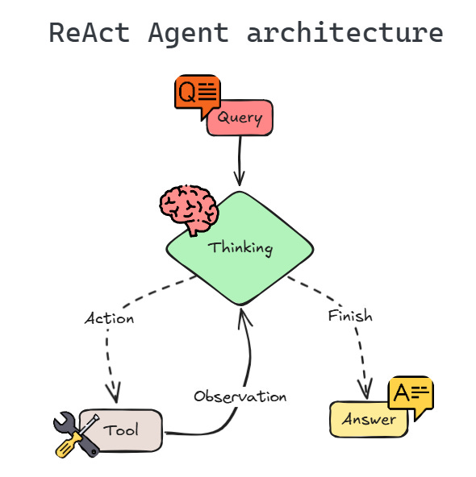
The agents brain: The Reasoning and Acting (ReAct) Loop Pt.1
thinking / reason (reasoning with the LLM)
acting (calling a tool)
observing (incorporating the tool's result)
LangGraph based implementation using nodes and edges =>
Notes:
In detail: 4 compinents to execute the cycle:
CORE REASONING ENGINE (LLM)
Toolbox
Worklfow orchstrator: calls Lllm for reason step, parses response for tool requests, calls tools , update smemore, decides when cycle is over
Agent memory (states), short term memory

Slide 14
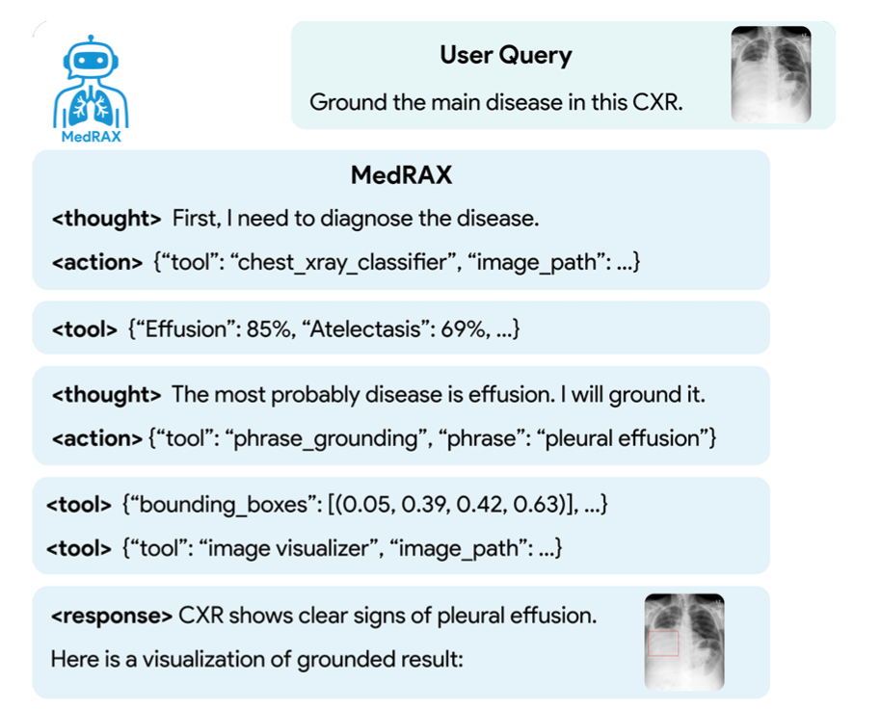









The agents brain: The Reasoning and Acting (ReAct) Loop Pt.2
Input is:
User Query & Images
+
Tool definitions
+
System Prompt
“You are an expert medical AI assistant …
Solve using your own vision and reasoning and use tools to complement your reasoning …
you can ask for additional info from user …”
Notes:
Userquery = question, CXRs, memory ; Tool def=name, descr, input args;
System Prompt: “You are an expert medical AI assistant who can answer any medical questions and analyze medical images similar to a doctor. Solve using your own vision and reasoning and use tools to complement your reasoning. Make multiple tool calls in parallel or sequence as needed for comprehensive answers. Critically think about and criticize the tool outputs. If you need to look up some information before asking a follow up question, you are allowed to do that.”
JSON responses: We process model responses using regex to extract letter choices.
For unclear responses, errors, or timeouts, we retry up to three times.
Responses that remain invalid or do not choose a single choice are marked incorrect

Slide 15
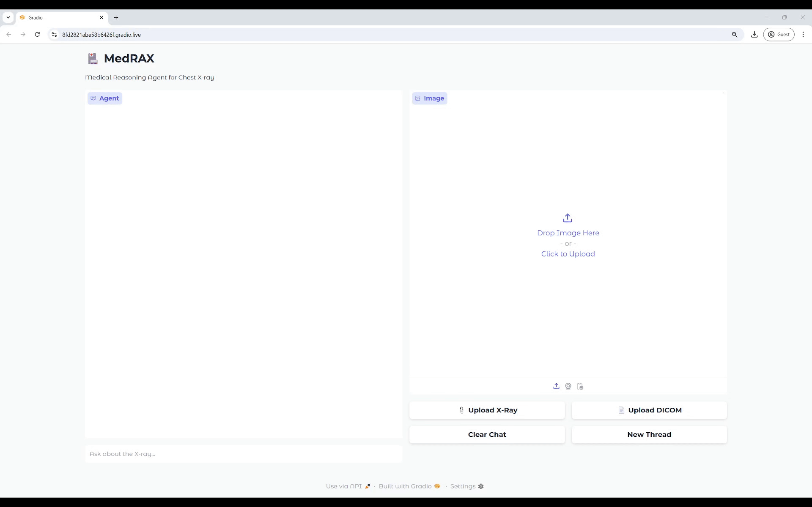
Demo of the MedRAX GUI
Notes:
They also implemented a GUI, the gif is a bit fast: segmentatino, gorunding, ask quesitons, comparison to another xray – and we see the tools called!

Slide 16
ChestAgentBench – A medical multi-step reasoning benchmark
Why a new one?
Existing medical VQA benchmarks focus on simple, single-steps reasoning tasks
ChestAgentBench uses only peer-reviewed clinical radiological case reports, including
patient histories
clinical presentations
multi-modal imaging findings => e.g. one ore more chest x-rays
Mirrors complex real-world clinical decision making
Notes:
- cover 53 unique areas of interest including lung, thorax, and mediastinum.

Slide 17
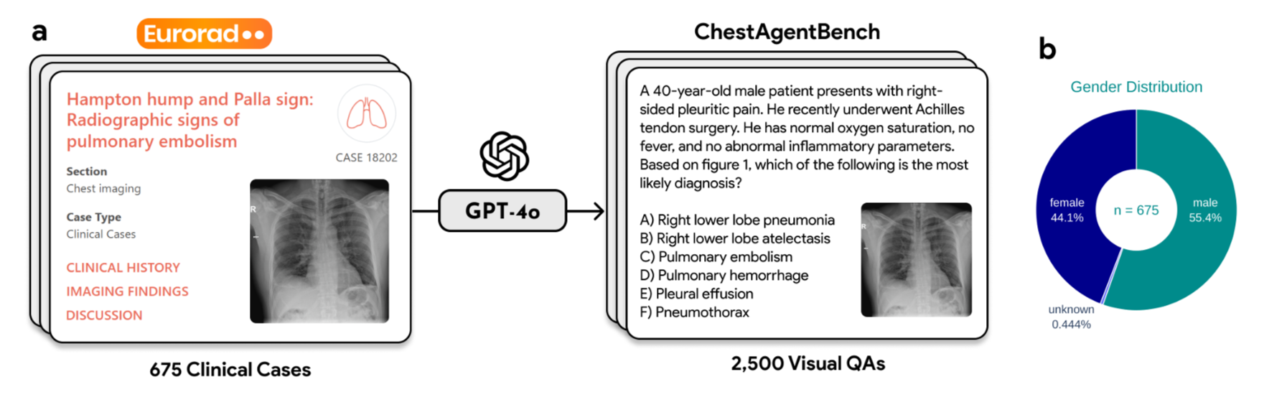
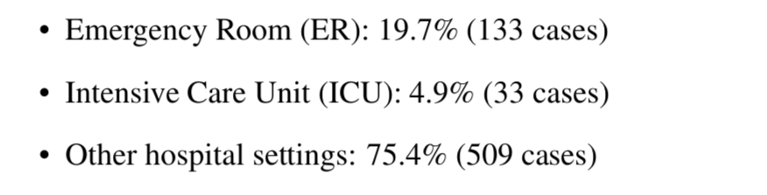
ChestAgentBench – A medical multi-step reasoning benchmark
How (a) and What (b)?
generated six-choice questions, based on 5 CXR competencies
Notes:
For each clinical case and question type =>GPT-4o to (2) analyze the case and generate a six-choice question for the type. (3) check question has the context from the clinical case and its correct answer could be explicitly verified from the case’s radiological findings and discussion
Detailed Finding Analysis: detection, localization, and characterization
Pattern Recognition & Relations: detection, classification, and relationships
Spatial Understanding: localization, comparison, and relationships
Clinical Decision Making: classification, comparison, and diagnosis
Diagnostic Characterization: classification, characterization, and diagnosis

Slide 18
ChestAgentBench
Tests 5 Question Types, based on essential CXR competencies:
Detailed Finding Analysis: detection, localization, and characterization
Pattern Recognition & Relations: detection, classification, and relationships
Spatial Understanding: localization, comparison, and relationships
Clinical Decision Making: classification, comparison, and diagnosis
Diagnostic Characterization: classification, characterization, and diagnosis
Notes:
Compared to other benchmarks:
CheXbench: mostly classification , doesn’t test reasoning or tool use
SLAKE: small-scale VQA, mostly single-turn, single-question tasks
MedAgentBench: few-shot generalist, not radiology-specific
RadQA / VQA-RADOften focus on VQA only, no report generation or segmentation evaluatio
ChestAgentBench focuses on multistep reasoning with medical priors
Fill a critical evaluation void for agent-based, tool-augmented CXR interpreters

Slide 19
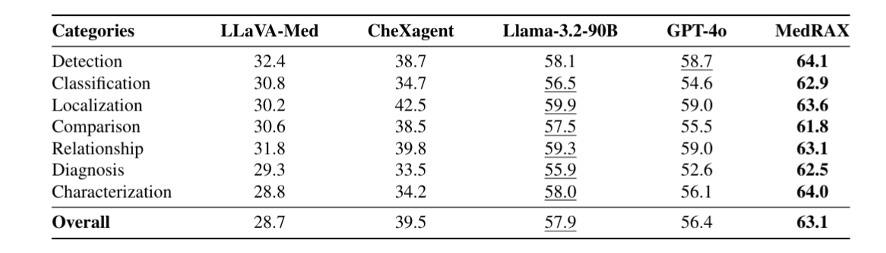


Quantitative Results 1/4 - ChestAgentBench
medical-domain models with <= 8B
=> General foundation models outperform specialists
Remember: MedRAX incorporates LLaVA-Med & CheXagent and GPT-4o
Notes:
SO how does MedRAX perform?
MedRAX outperfoms spercialized and general purpose models on their own 2500 CXR benchmark. (simple accuracy of six-choice)
Interestingly, general purposeVLMs outperform domain-specific ones acrossall categories, esp. characterization and diagnosis!
NOTE: MedRAX basically calls GPT4.0, llavamed, chexagent MULTIPLE TIMES, in this benchamark the others are called only once!

Slide 20
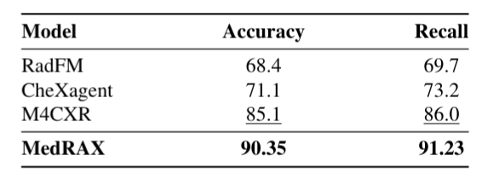


Quantitative Results 2/4 – SLAKE VQA
Good performance on VQA tasks
M4CXR with impressive performance, sadly no comparison to LlavaMed
Notes:
SLAKEVQA: medical VQA on 114 chestX-raytest samples with close-endedquestionsinEnglish: Measurement in ACC(exactmatches)and recall(proportionof groundtruthwordspresentingeneratedresponses)
RESULTS: clear outperformance on VQA tasks, M4CXR: multimodal VQA , grounding and report model;Transformer, 1-10B params,

Slide 21
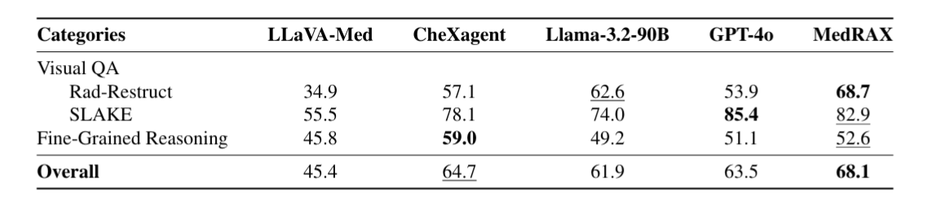


Quantitative Results 3/4 – CheXbench
Image-text reasoning proposes challenges to all models
Interestingly CheXAgent outperforms MedRAX on reasoning tasks
=> is MedRAX hindered by LlavaMed in VQA reasoning tasks?
Notes:
ChexBench: evaluates seven clinically-relevant CXR interpretation tasks Accuracy(%). 238 VQA from Rad-Restruct and SLAKE AND 380 fine-grained image-text reasoning: RESULTS: - MedRAX excelsin VQA while achieving the best overall performance – looses out in fine grained reasoning compared to only foundation model chexagent; Same SLAKE as before but different reuslts – now with LLavaMed ateast,
Fine grained reasoning (multi step, context – discriminate between closely related findings, multiple choice): Almost equal to random performance(50%baseline). => maybe another tool for this use case using chexagnet would have been useful?

Slide 22
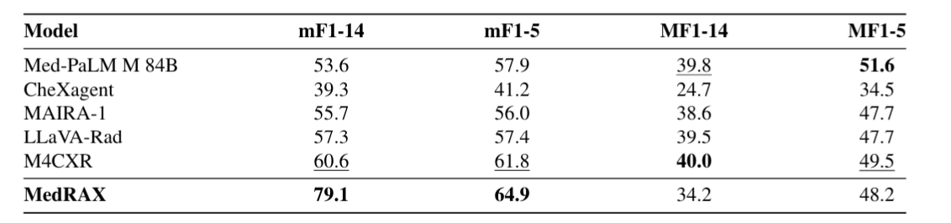


Quantitative Results 4/4 – MIMIC-CXR
=> MedRAX structure provides
good performance on common diseases, but
bad performance on rare diseases!
Notes:
MIMIC_CXR: 3,858 single-image CXR : asseses clinical accuracy of generated reports using micro & MACRO averaged F1 scros for 14 medical observation labels and 5 key findings (cardiomegaly,edema, consolidation,atelectasis,pleuraleffusion) –
- F1: mean of Precision (of all Pos Pred, how many actuallly?) and Recall (Of all actual positives, how many did the model catch?)
- Micro-F1: (weighted per freq of label in dataset)=aggr TP, FP, FN over all labels, then compute F1 once: treats all label decisions equally across the dataset =>Sensitive to common conditions
- Macro-F1: compute per label, then avg: treats all labels equally, even rare ones => Sensitive to rare condition performance
RESULTS: MedRAX: hhigh microF1 , but low MACROf1 scores => good performance on common diseases, bad performance on rare diseases!

Slide 23


Discussion: Limitations
Conflicting Tool Outputs
Struggles when classification and segmentation tools disagree on fine-grained findings
Computational Overhead
ReAct Loop means multiple calls to specialist tools and LLM brain, meaning
higher latency vs. monolithic end-to-end models
higher costs
=> not evaluated in paper!
Lack of Uncertainty Quantification
No principled confidence estimates or error bounds on combined tool outputs
Choice Of Tools leaves room for optimization
Also not discussed in detail in paper

Slide 24
Conclusion on MedRAX
It's a highly modular framework
tools & reason LLM engine can be very easily exchanged
Bridging Specialists vs. Generalists
Agentic systems provide a solution
Increased transparency:
logs of tool calls and outputs
State of the art in CXR-VQA
Provides a unified framework to leverage strengths of different models
Notes:
We see foundation models >80B params outperform specialists, hwoever in medical domain we lack the needed amount data (atm)! => agents are a solution: „we see thath explicit decomposition of tasks provides advantages that scale alone cannot achieve”
However, the fragmented nature of these solutions—each operating in isolation—has hindered their widespread adoption
A key insight is the superior performance of general-purpose models (GPT4o, Llama-3.2-90B) over specialized medical models
State of the art in VQA:
can be further improved by optimizing model (tool) choices
+ ChestAgentBench provides a well curated, meaningful benchamrk for CXR

Slide 25
Thank you for your time ☺
Questions?

Slide 26
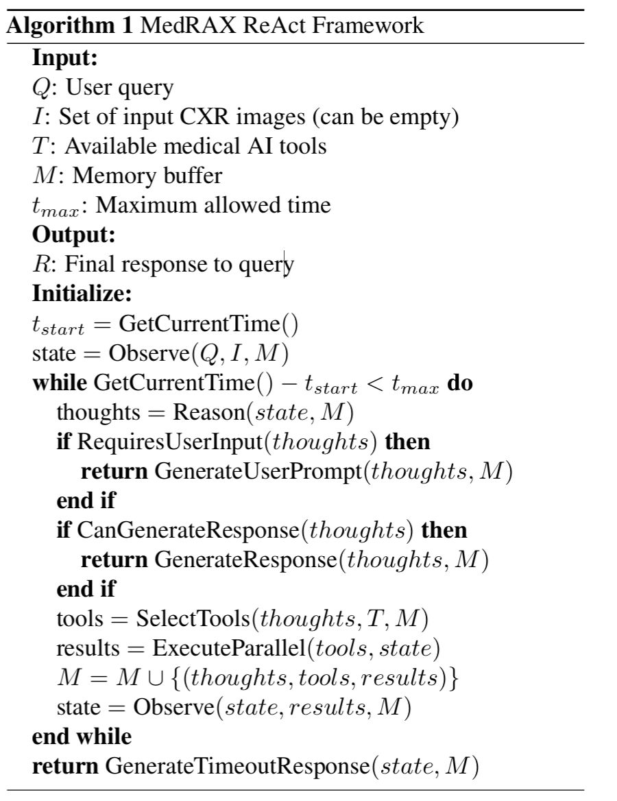
Appendix

Slide 27
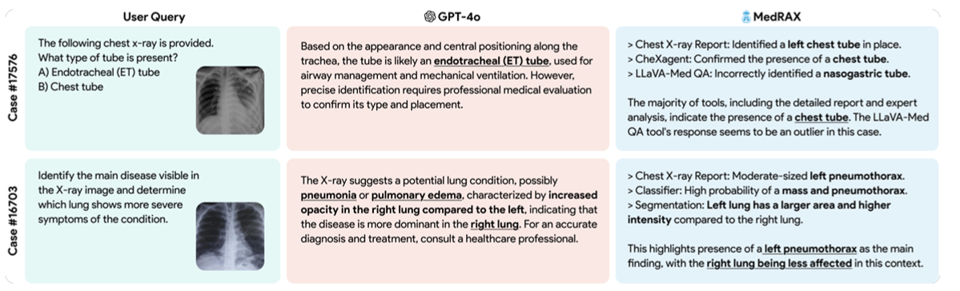
An interesting case study vs. GPT-4o
Notes:
. (Case 17576) Correct answer is chest tube. GPT-4o incorrectly identifies as endotracheal tube based on position, while MedRAX correctly identifies chest tube by integrating multiple tool outputs, even resolving conflicting tool suggestions.
(Case 16703) Correct answer is left pneumothorax. GPT-4o misdiagnoses as right-sided pneumonia/edema, while MedRAX correctly identifies left pneumothorax through sequential tool application for disease detection and comparative lung analysis

Slide 28
Appendix
MedRAX employs the following system prompt to guide the reasoning engine:
“You are an expert medical AI assistant who can answer any medical questions and analyze medical images similar to a doctor.
Solve using your own vision and reasoning and use tools to complement your reasoning.
Make multiple tool calls in parallel or sequence as needed for comprehensive answers.
Critically think about and criticize the tool outputs.
If you need to look up some information before asking a follow up question, you are allowed to do that.”

Slide 29
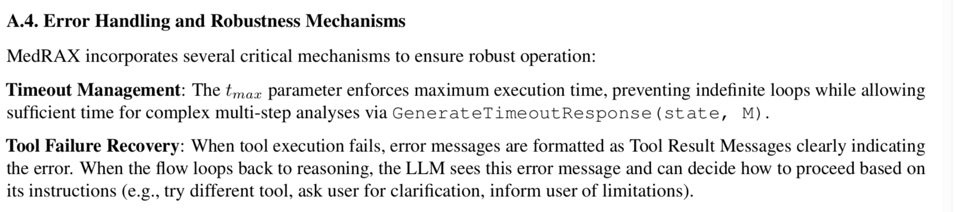
Appendix

Slide 30
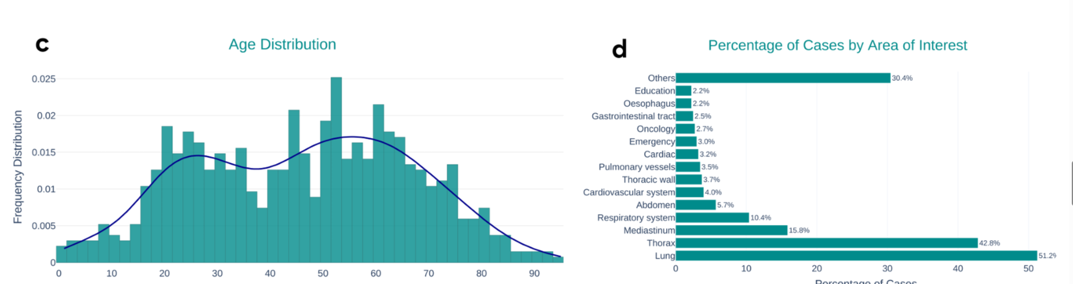
Appendix

Slide 31
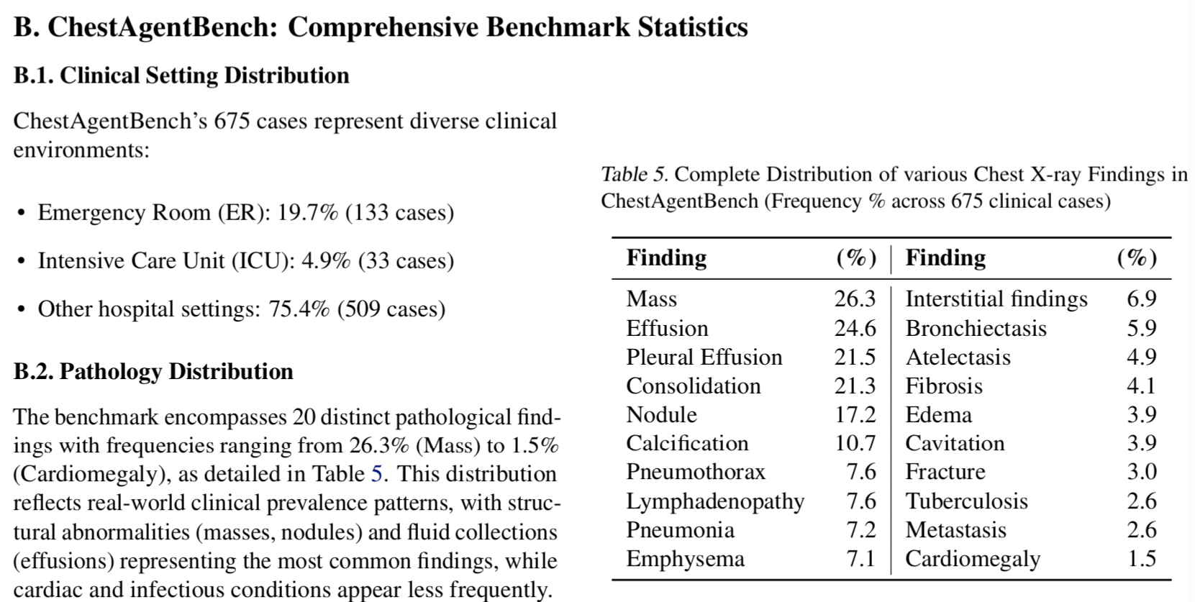
Appendix

